Slide 1
SKILL BRIDGE STARTUP PROJECT
From Learning to Earning

Slide 2

AGENDA
Problems
Solution
Features
Challenges
Growth plan
_______________________

Slide 3

What is the problem?
Lack of skills and Technology awareness
Limited access to quality education
Unemployment

Slide 4
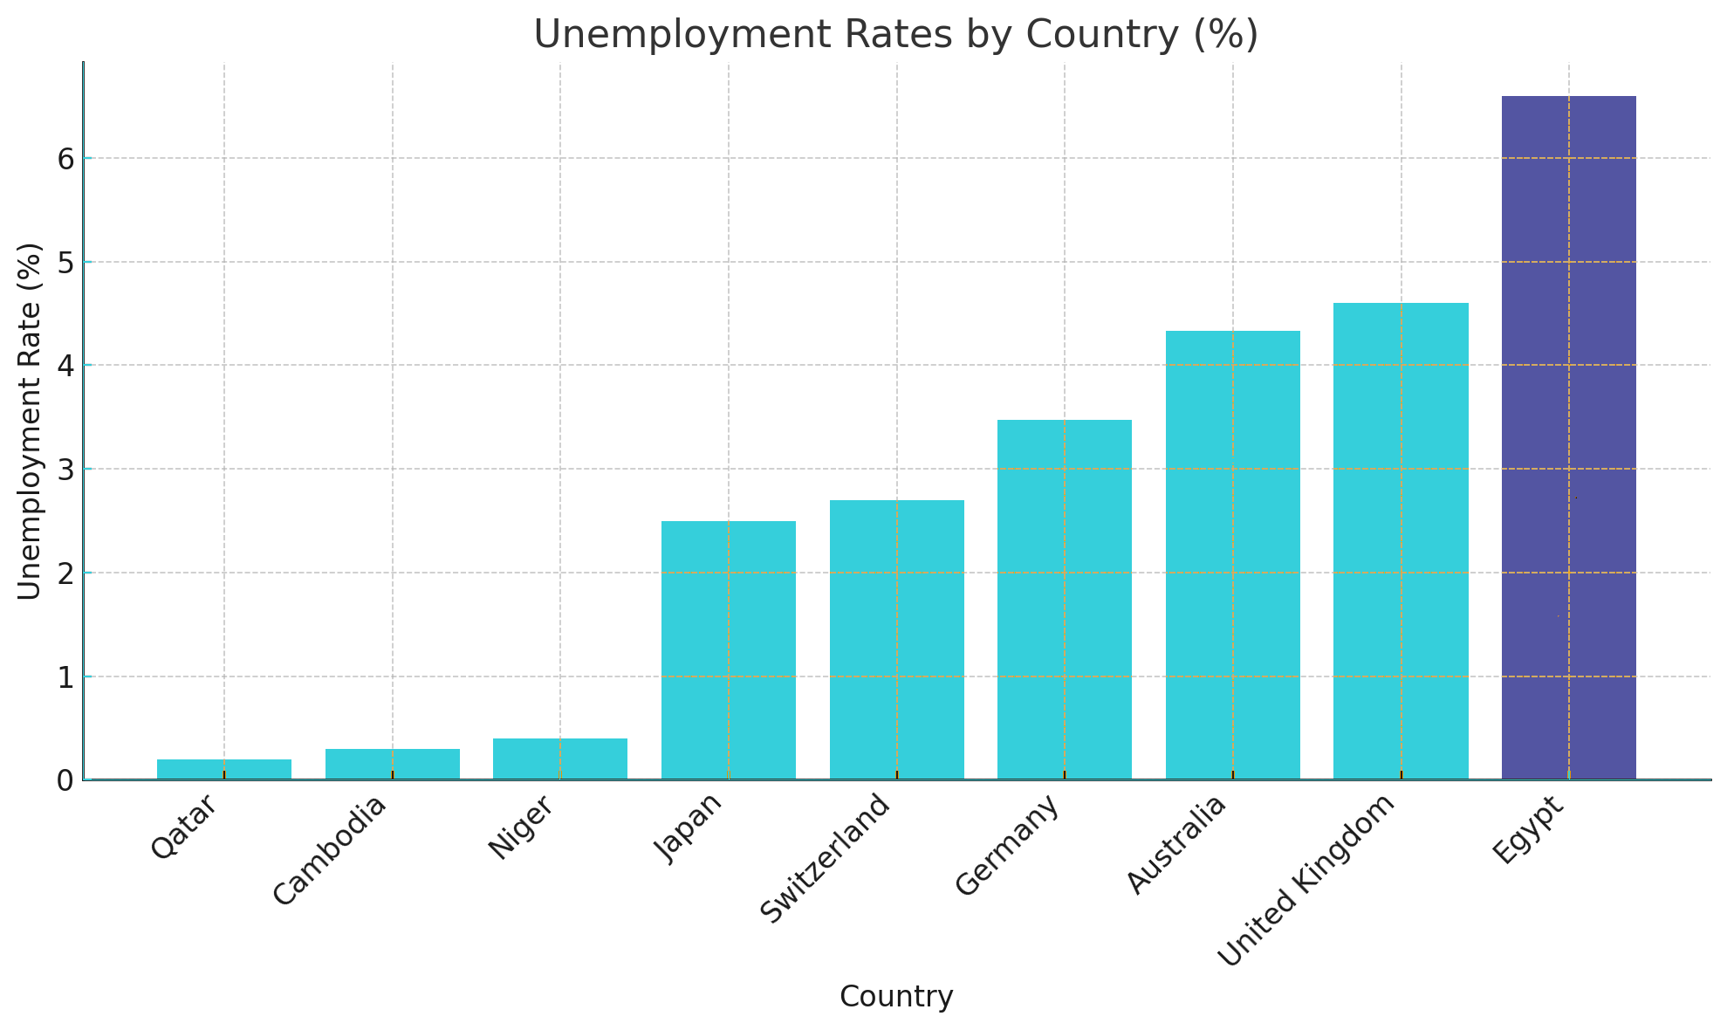
Graph

Slide 5
Our Solution
STEP 3
We will provide job opportunities.
STEP 1
We provide affordable variety of courses in Technology field.
The 3 steps are …
STEP 2
We get them prepared to job market by helping them building a strong CV.

Slide 6
Features
AI Chatbot
Community
24/7 Customer support
Easy navigation

Slide 7
Challenges
Provide variety of tutors
Market-Driven curriculum, hiring partnerships
Discounts

Slide 8
Our growth plan
First month
8 months
Second month
Social media
Events & Universities
expand into neighboring countries

Slide 9
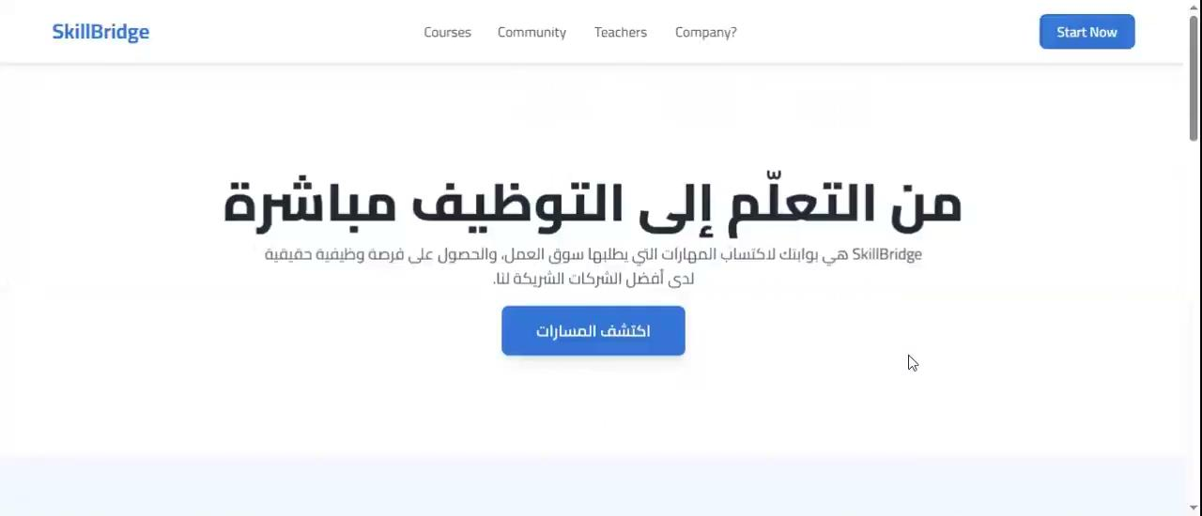
Our Web

Slide 10
Financial Overview & Ask
Cost Breakdown
Students | Revenue | Net profit
500 | 500,000 | 200,000
1000 | 1,000,000 | 700,000
2000 | 2,000,000 | 1,700,000
Website hosting and domain
10,000
Marketing and ads
20,000
The Ask
We need EGP 300,000 in funding to cover the first-year expenses, including hosting, marketing, content creation, and team salaries. With an average course price of EGP 1,000 and a target of 1,000 students in the first year, we project EGP 1M in revenue and EGP 700K net profit.
_______________________________
Development and Technical support
150,000
Salaries
120,000
______________________________________________________________
Total
300,000

Slide 11
Resources
Unemployed %
Al Masdar
Fedcoc
Al youm 7
Vectors
Hand drawn metaverse landing page
Hand drawn metaverse webinar template
Hand drawn metaverse sale banner template
Hand drawn geometric metaverse facebook post
Hand drawn geometric metaverse twitch background
Hand drawn geometric metaverse facebook cover
Gradient metaverse background

Slide 12
Fonts & colors used
#ffffff
#eddeff
#92f7ff
#35cfdb
#0f89a5
#a6abff
#3f3fd8
#3333b8
#09066a
#0d092a

Slide 13
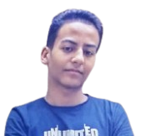
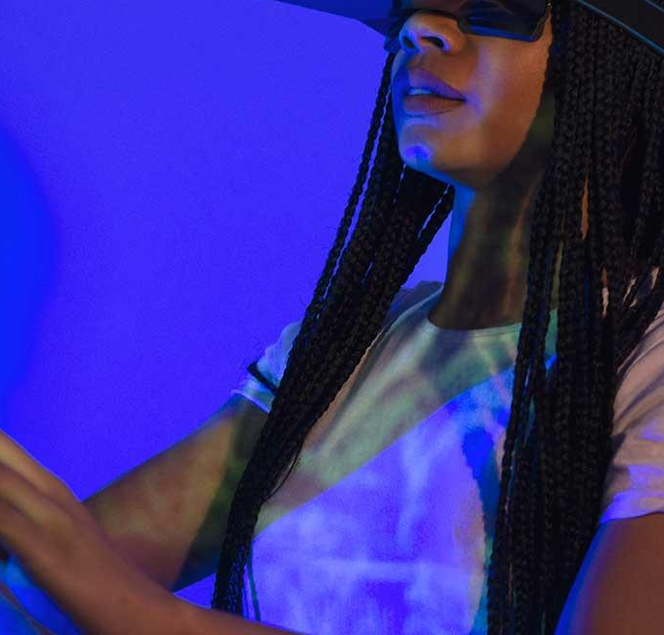
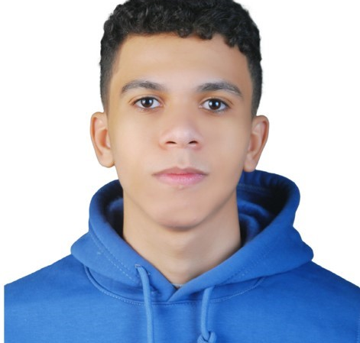
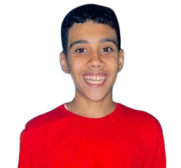
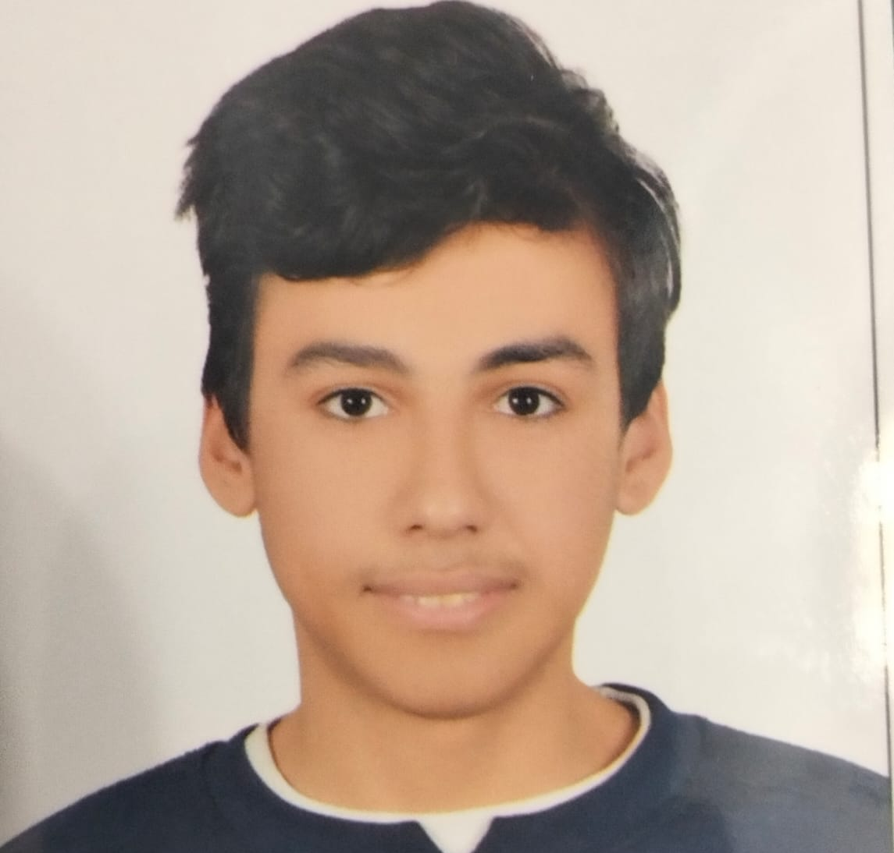
Our team
USIF
arwa
Youssef
moaz
Ali
Leader
Designer
Technical Founder
Love the god
maker

Slide 14
Any questions ?

